Slide 1
Swift Drive

Slide 2






Happy Holi
1
isBipartite
2
Colors with DFS
3
Return

Slide 3
Clean Up
Arguments wins the HEARTS

Slide 4
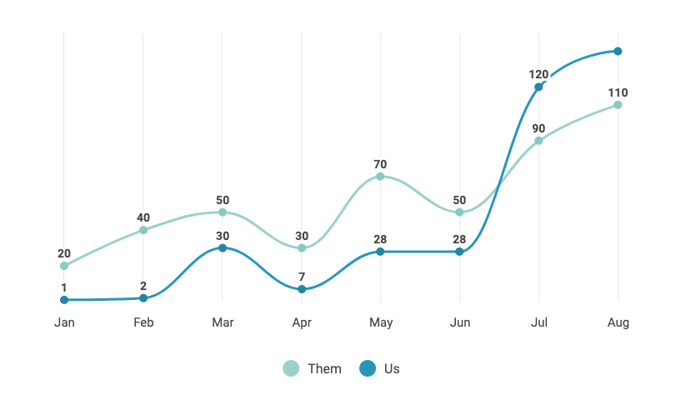

Phase Three
2019 Growth Projection
140
400%
August over June
By implementing automated marketing tools and expanding our reach country-wide, we expect to quadruple our customer ba

Slide 5
General Customer Service

Slide 6

Executive Summary
Product
Market
Include your mission statement and product description
A description of your target market and the competitive landscap
- Refined Methods
- 100+ Countries
Financial
Team
Financial overview and funding needs
Relevant qualifications or background
- Progressive Requirements
- Largely Democratic Values

